Slide 1
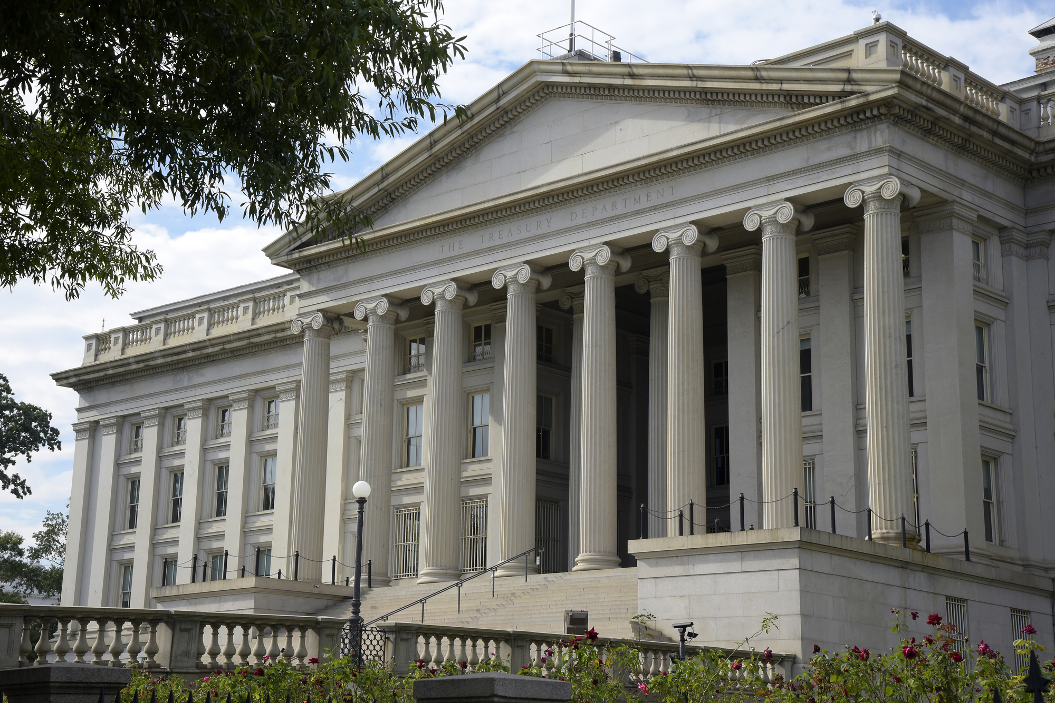
SAP Treasury & Risk Management
Author :AIERP1

Slide 2
SAP Treasury & Risk Management-1
End to End Business Scenarios :Money Market Instruments
  Fixed Term Deposits
  Interest Rate Instruments – Fix/ Variable Interest rates
  Facilities
  Commercial Paper
End to End Business Scenarios: Foreign Exchange Transactions
  FX Spot
  FX Forward
  FX Non-Deliverable Forwards
SAP Treasury Month End Processing

Slide 3
SAP Treasury & Risk Management-2
SAP Configuration : Money Market Instruments
  Fixed Term Deposit
  Interest Rate Instruments
  Facilities
  Commercial Paper
SAP Configuration : FX Instruments
  FX Spot
  FX Forward
  FX NDF
Mini Treasury Project implementation and Testing

Slide 4
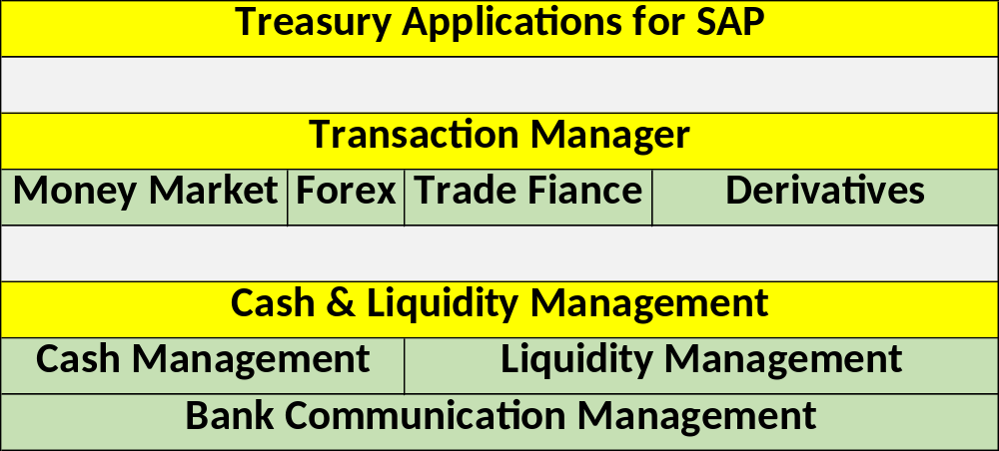
SAP TRM- Business Process-1

Slide 5
SAP TRM- Business Process- 5
Fixed Term Deposit
  A fixed-term deposit is a financial product where an individual or company deposits money into a financial institution for a set period. In exchange, the depositor receives a set interest rate. At the end of the term, the depositor receives their original investment plus compound interest. The length of the term can be six, nine, 12, or 24 months, depending on the bank's product. The depositor can choose how they receive interest payments, either monthly or at maturity
Interest Rate Instruments :
  An interest rate instrument is a money market transaction with additional structural characteristics, such as Fixed, Variable interest rate. Interest Payable on maturity or at specified interval like monthly, quarterly etc.
Commercial Paper
  Commercial paper is a form of unsecured, short-term debt.
  Commercial paper is issued at a discount and matures at its face value.
  It's commonly issued by companies to finance their payables, inventories, and short-term liabilities.
  Maturities on commercial paper range from one to 270 days

Slide 6
SAP TRM- Business Process- 6
Credit Facilities
  A credit facility is an agreement between a lender and a borrower that allows for greater flexibility than traditional loans. Types of credit facilities include revolving loan facilities, committed facilities, letters of credit etc.
  However, a credit facility usually comes with additional maintenance fees, withdrawal fees, Fees- Utilization, Non utilization
FX Spot trade
  An FX spot trade, or foreign exchange spot transaction, is an agreement between two parties to buy one currency and sell another at an agreed price on a specific date. The exchange rate at which the transaction occurs is called the spot exchange rate.
  Most spot market transactions have a T+2 settlement date.
FX Forward trade
  An FX forward is a contractual agreement between the client and the bank, or a non-bank provider, to exchange a pair of currencies at a set rate on a future date.

Slide 7
SAP TRM- Business Process- 7
FX Non-Deliverable Forwards
  An NDF is fixed for an agreed amount (of the non-convertible currency), on a specific due date, and at a defined forward rate.
  At maturity, the forward rate is compared against the reference rate (Spot Rate) of that day. The difference between the pre-agreed forward rate and the fixing rate (Spot Rate) is settled in the convertible currency (USD, EUR) on your account on the due date.
  Therefore, you will either pay or receive the difference.
  NDF Currencies
    Egypt (Egyptian pound)
    South Korea (won)
    Taiwan (Taiwanese dollar)
    India (rupee)
    Venezuela (bolivar)

Slide 8
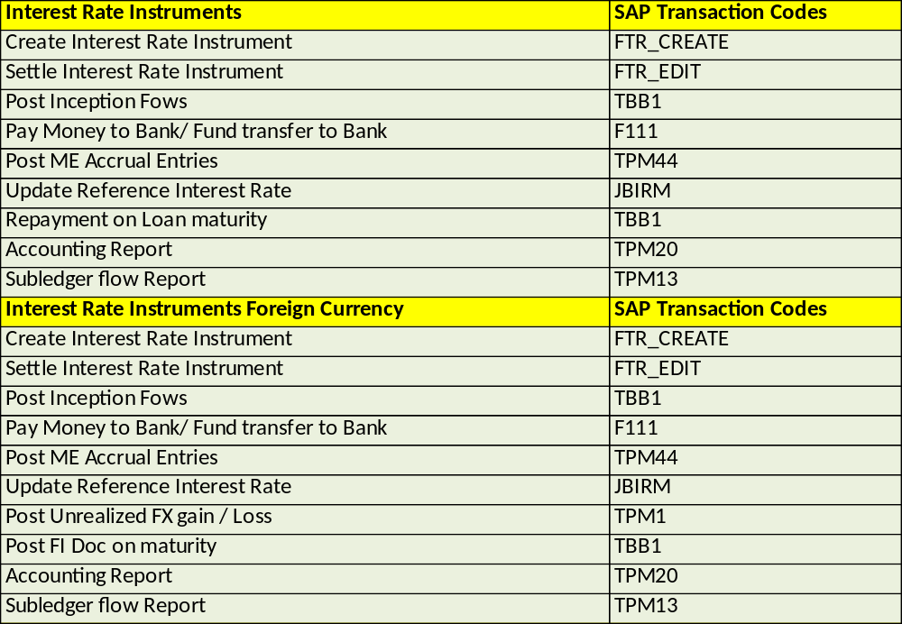
SAP TRM- Business Process-2

Slide 9
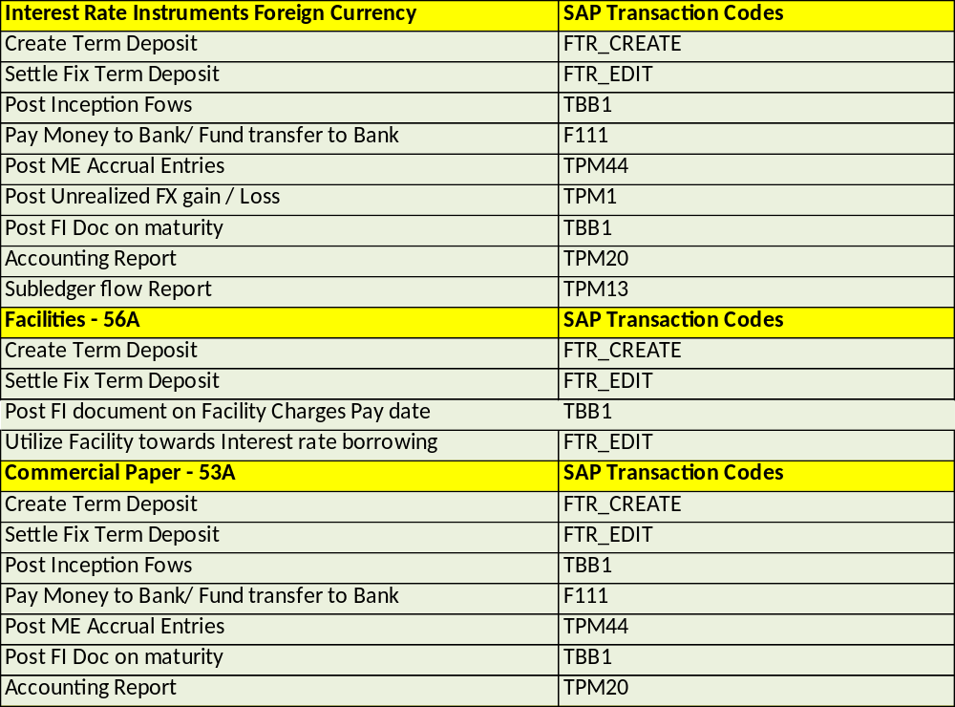
SAP TRM- Business Process-3

Slide 10
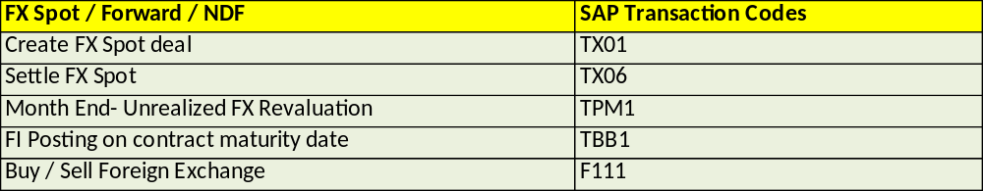
SAP TRM- Business Process- 4

Slide 11
SAP TRM- Configuration -1
General Settings
TRM - General Settings
Ex Rate Calculation Indicator | FSCM-TRM-TM-General Settings-Organization
Define Co Code Additional Data | FSCM-TRM-TM-General Settings-Organization
Define Portfolio | FSCM-TRM-TM-General Settings-Organization
Define Traders | FSCM-TRM-TM-General Settings-Organization
Define User Data | FSCM-TRM-TM-General Settings-Organization

Slide 12
SAP TRM- Configuration -2
Transaction Management : Money Market, Foreign Exchange, Derivatives
Define Product Types | FCSM-TRM-TM-Money Market-Transaction Management-Product Types
Define Number Ranges | FCSM-TRM-TM-Money Market-Transaction Management-Transaction Type
Define Transaction Type | FCSM-TRM-TM-Money Market-Transaction Management-Transaction Type
Define Flow Types | FCSM-TRM-TM-Money Market-Transaction Management-Flow Types
Assign Flow Types to Transaction Types | FCSM-TRM-TM-Money Market-Transaction Management-Flow Types
Define Update Types and Assign Usages | FCSM-TRM-TM-Money Market-Transaction Management-Update Types-Define Update Types and Assign Usages
Assign Flow Types to Update Types | FCSM-TRM-TM-Money Market-Transaction Management-Update Types-Assign Flow Types to Update Types
Define Condition Types | FCSM-TRM-TM-Money Market-Transaction Management-Condition Types-Define Condition Types
Assign Condition Types to Transaction Type | FCSM-TRM-TM-Money Market-Transaction Management-Condition Types-
Position Indicator | FCSM-TRM-TM-Money Market-Transaction Management-Position Indicator-Define Generation of Subledger Position Indicator
Assign General Valuation Class | FCSM-TRM-TM-Money Market-Transaction Management-Assign General Valuation Class
Assign Forex Attributes

Slide 13
SAP TRM- Configuration -3
Financial Accounting Integration
Define Valuation Area | FSCM-TRM-TM-General Settings-Accounting-Organization
Define Accounting Code | FSCM-TRM-TM-General Settings-Accounting-Organization
Assign AC and Valuation Area | FSCM-TRM-TM-General Settings-Accounting-Organization
Assign Ledger group to Accounting Principle | financial Accounting (New)-Financial Accounting Global Settings (New)-Ledgers-Parallel Accounting-
Define and Assign Valuation Classes | FCSM-TRM-TM-General Settings-Accounting-Settings for Position Management
Assign GVC to Group | FCSM-TRM-TM-General Settings-Accounting-Settings for Position Management
Set the Effects of the Update Types on the Position Components | FCSM-TRM-TM-General Settings-Accounting-Settings for Position Management
Foreign Currency Valuation Procedure | FCSM-TRM-TM-General Settings-Accounting-Settings for Position Management-Key Date Valuation-Define Foreign Currency Valuation Procedure
Define Position Management Procedure | TRM-TM-General Settings-Accounting-Settings for Position Management
Assign Position Management Procedure | TRM-TM-General Settings-Accounting-Settings for Position Management-Assign Position Management Procedure
Update Types for Key date valuation | TRM-TM-General Settings-Accounting-Key Date Valuation-Update Types-Define Update Types and Assign Usage
Assign Update Types for Valuation | TRM-TM-General Settings-Accounting-Key Date Valuation-Update Types-Assign Update Types for Valuation
Update Types for Derived Business Transactions | TRM-TM-General Settings-Accounting-Derived Business Transactions-Update Types-Define Update Types and Assign Usage
Assign Update Types for Derived Business Transactions | TRM-TM-General Settings-Accounting-Derived Business Transactions-Update Types
Control of Processing of Derived Business Transactions | TRM-TM-General Settings-Accounting-Derived Business Transactions- Control of Processing of Derived
Define update types for Accrual/Deferral | TRM-TM-General Settings-Accounting-Update Types-Define Update Types and Assign Usages
Assign Update Types for Accrual/Deferral | TRM-TM-General Settings-Accounting-Update Types-Define Update Types and Assign Usages
Indicate Update Type as Relevant to Posting | TRM- TM- General Settings - Accounting - Link to Other Accounting Components-Indicate Update Type as Relevant to Posting
Define Account Assignment Reference | TRM-TM-General Settings-Accounting-Link to Other Accounting Components-Define Account Assignment References
Define Accounting Assignment Determination (OTC Transaction) | TRM-TM-General Settings-Accounting-Link to Other Accounting Components-Define Account Assignment References Determination (OTC Transaction)
Define Account Determination | TRM-TM-General Settings-Accounting-Link to Other Accounting Components-Define Account Determination

Slide 14
Thank You
Thank You

